Slide 1
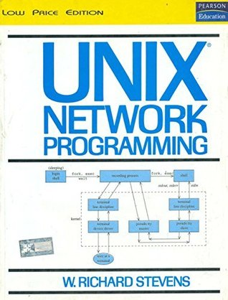
Network Programming

Slide 2
Unit – I
Introduction
Client/server communication
OSI Model
BSD Networking history
Test Networks and Hosts
Unix Standards
64-bit architectures
Transport Layer: TCP, UDP and SCTP,
TCP Connection Establishment and Termination.
Self learning topics: TCP/IP Protocols in nut shell.

Slide 3
Network programming involves writing programs to communicate with processes either on the same or on other machines on the network using standard Protocols…

Slide 4
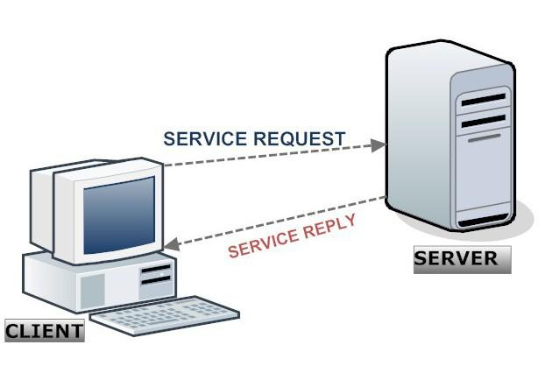
High-level decision must be made as to which program would initiate the communication first and when responses are expected…
WebServer program waits for clients to send request and only after the request is received it responds with a reply…

Slide 5
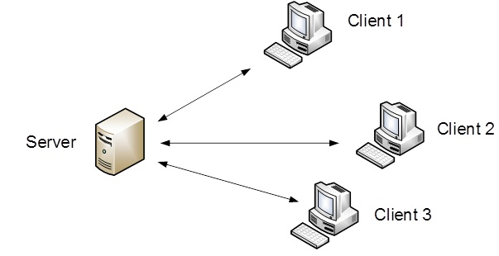
Single Server – Serving multiple Clients
https://www.youtube.com/watch?v=1z0ULvg_pW8

Slide 6
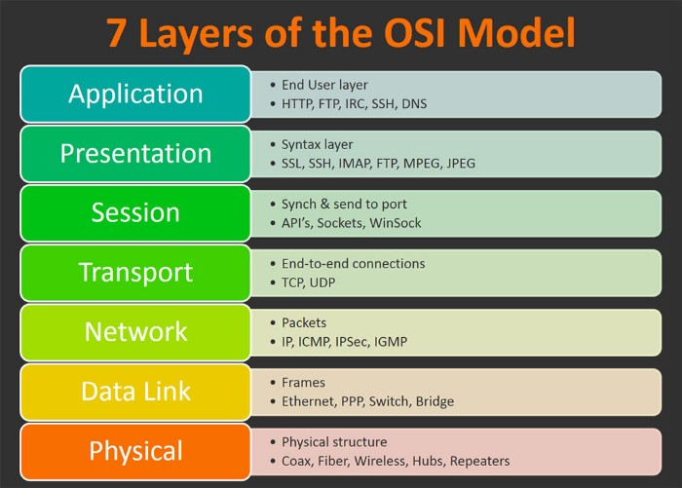
OSI - Model

Slide 7
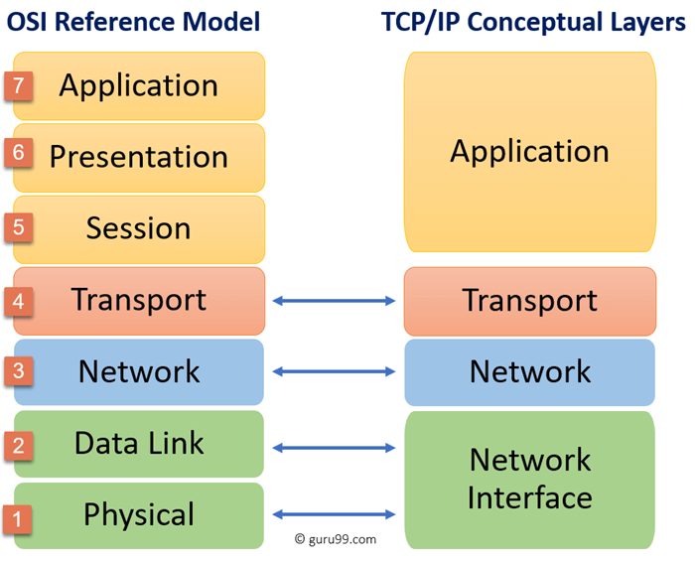
TCP/IP Model

Slide 8
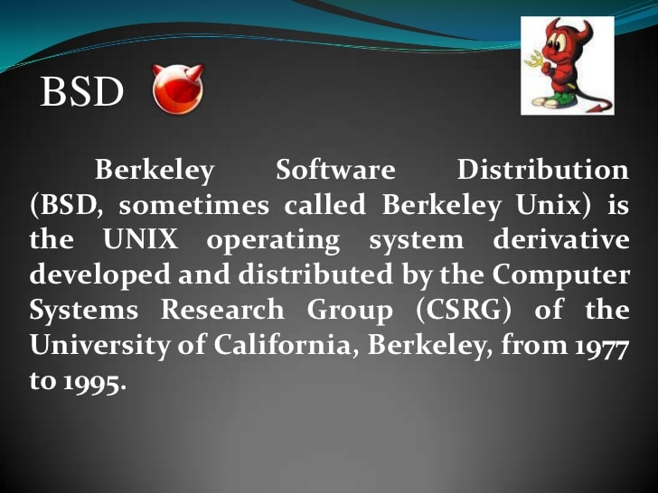
BSD

Slide 9
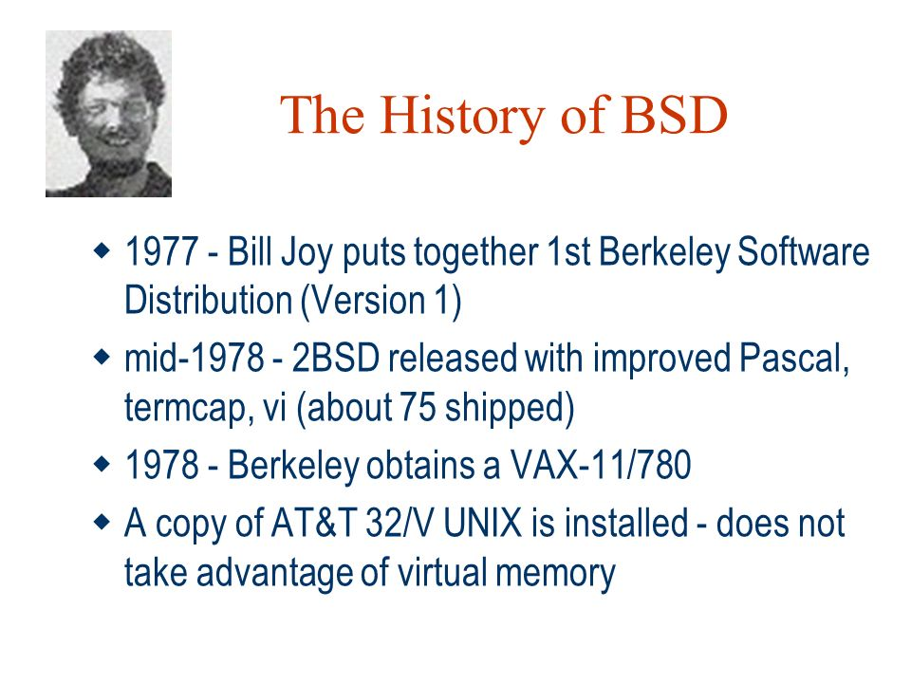
BSD

Slide 10
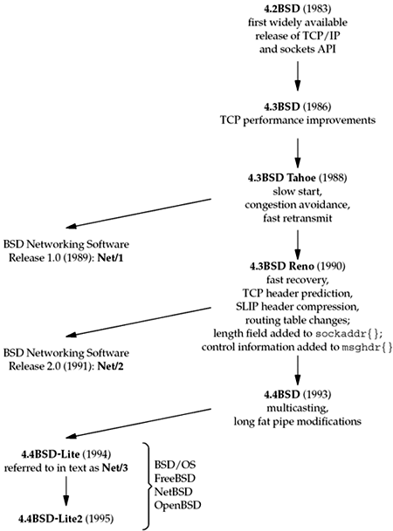
BSD History

Slide 11
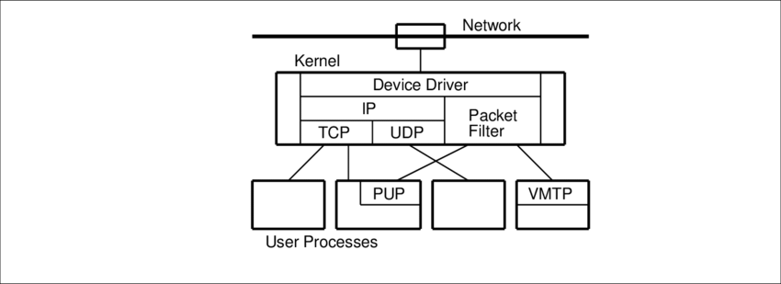

BSD Network
Potentially Unwanted Applications
Versatile Message Transaction Protocol

Slide 12
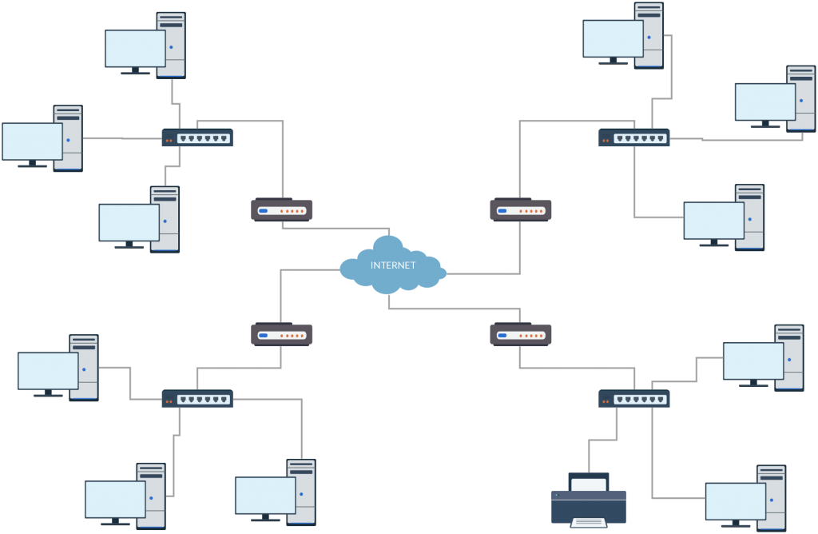
Test Network and Hosts

Slide 13
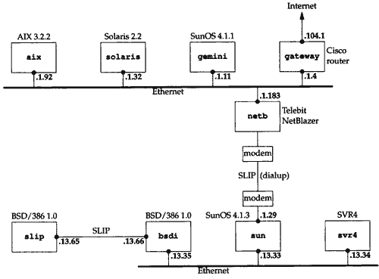
Test Network and Hosts

Slide 14
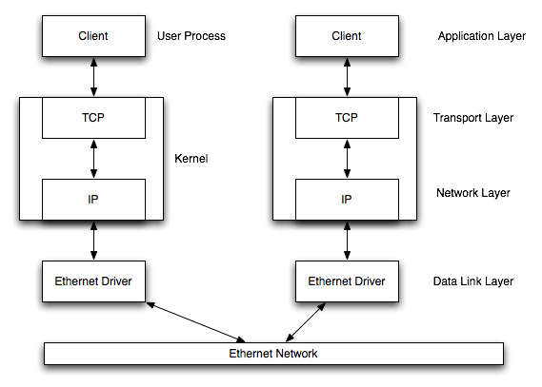
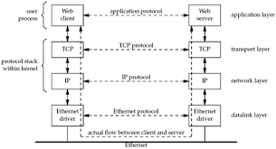
Communication over LAN

Slide 15
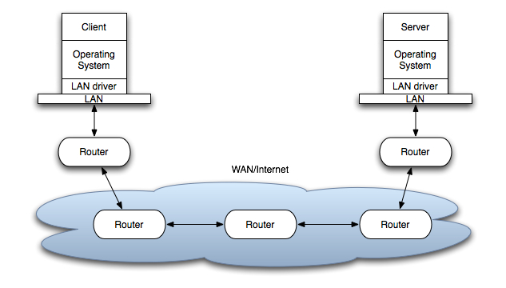
Communication over WAN

Slide 16
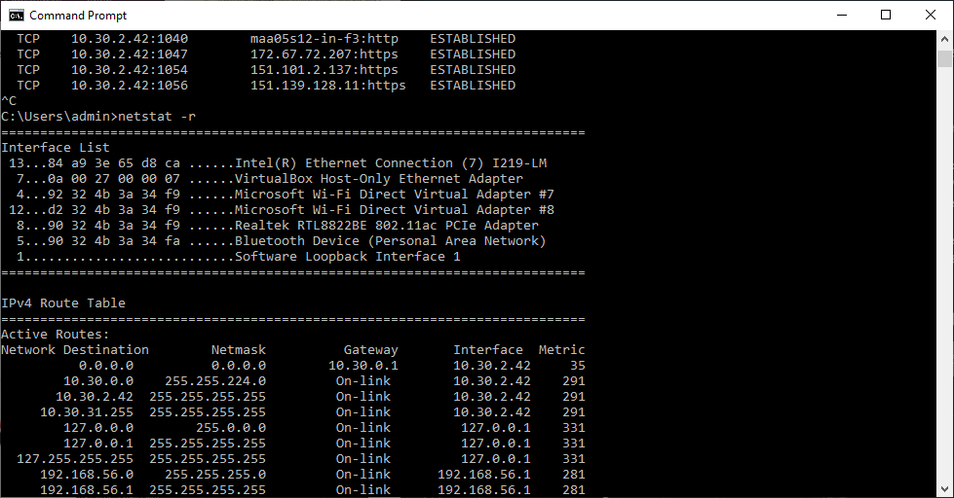
Discovering Network Topology – netstat –ni and netstat -r
Options | Meaning
-a | All ( TCP, UDP, SCTP, ICMP )
-n | Numeric addresses
-b | Display executables
-o | Process id
-f | Fully Qualified domain name
-p proto | Specific protocols
-r | Routing table
-s | Protocol statistics
-t | Current connection network status

Slide 17
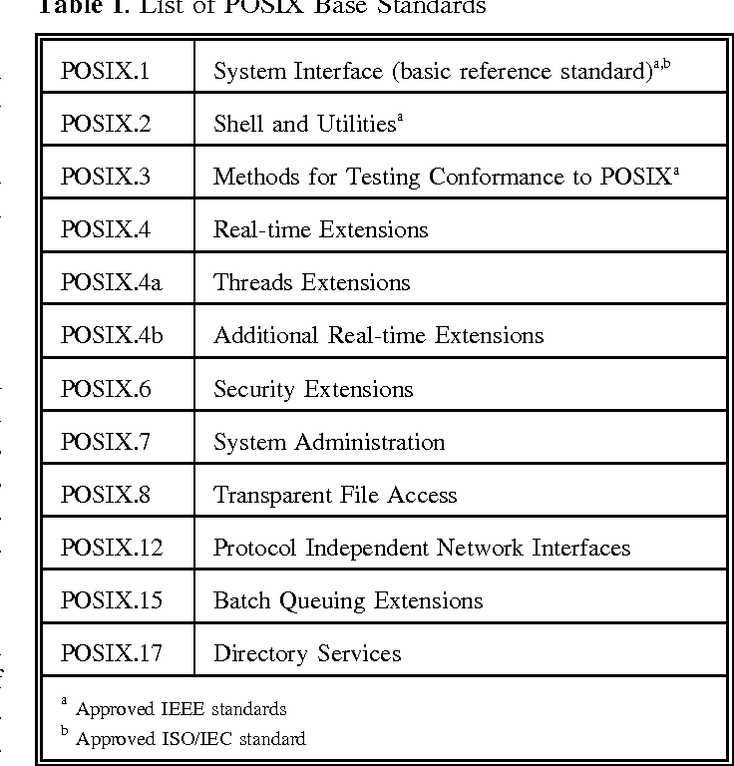
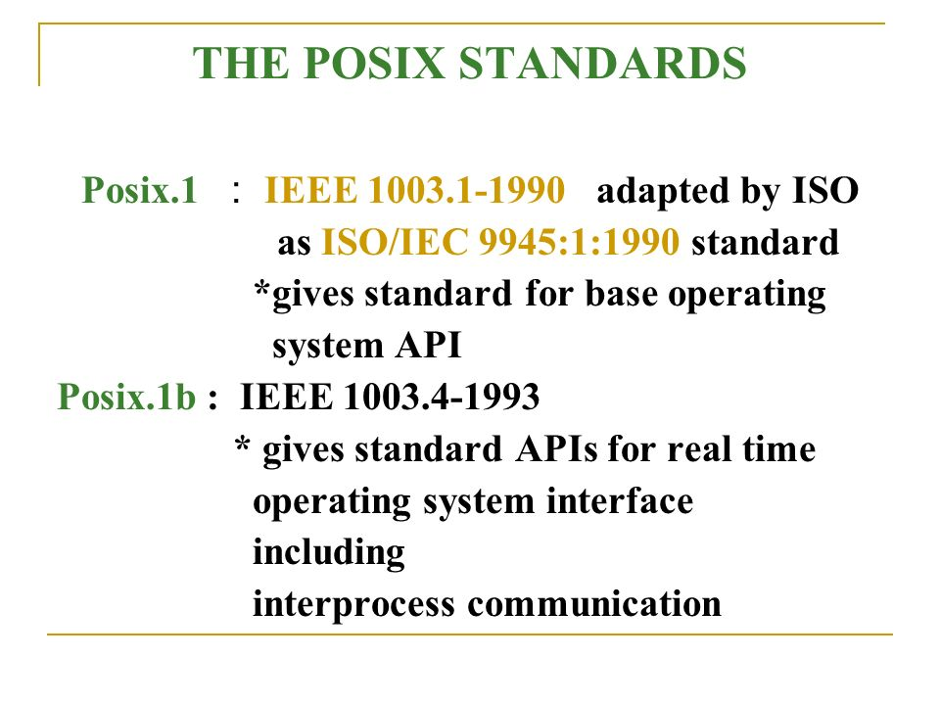
Unix Standard - POSIX
Posix.1c : Threads and Extensions

Slide 18
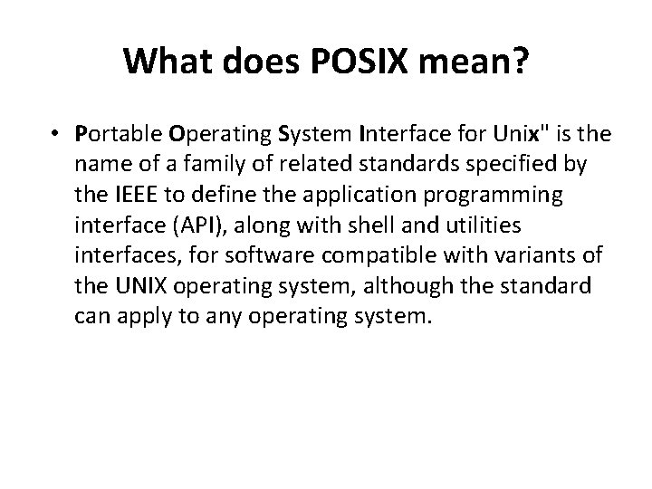
Unix Standard - POSIX

Slide 19
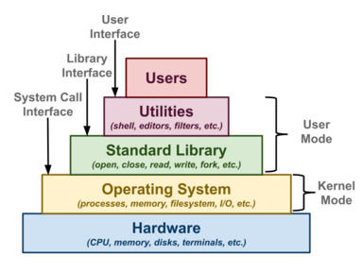
Unix APIs

Slide 20
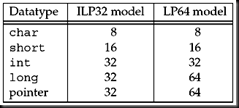
64 Bit Architectures

Slide 21
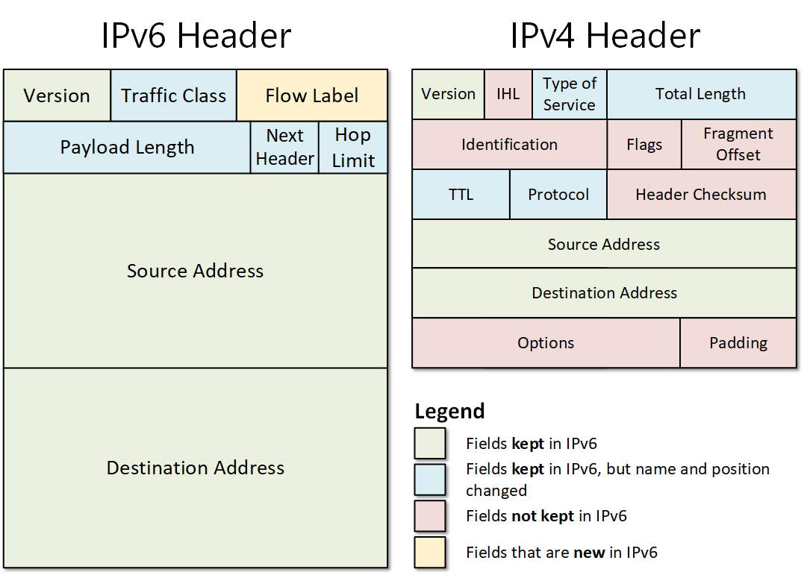
64 Bit Architectures

Slide 22
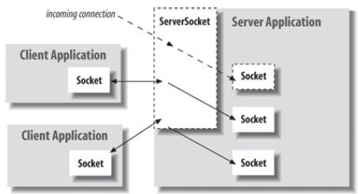
Sockets : An end point for communication between processes across the network

Slide 23
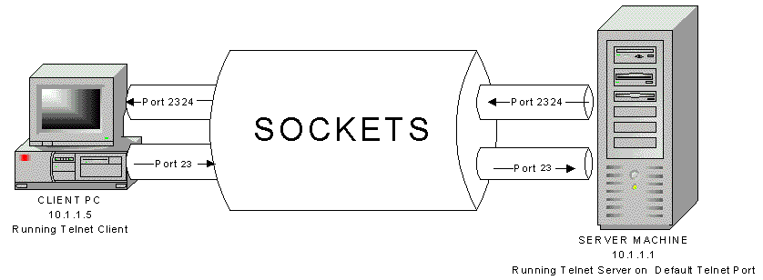
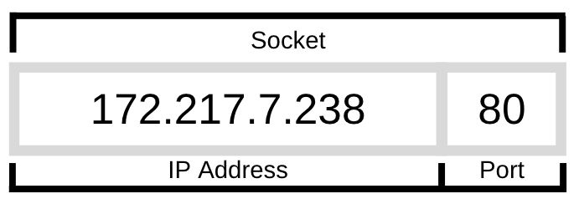
Sockets : An end point for communication between processes across the network

Slide 24
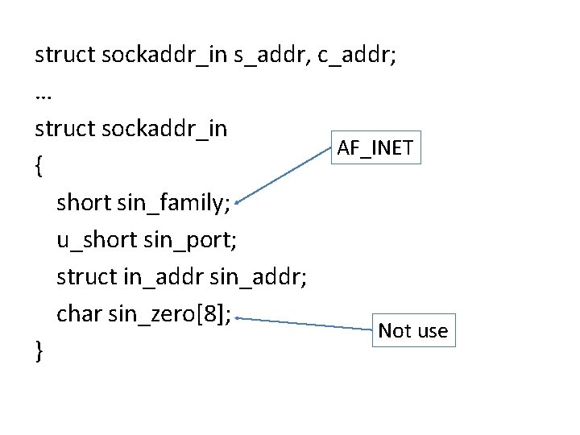
Sockets : An end point for communication between processes across the network
struct in_addr { unsigned long s_addr;
};

Slide 25
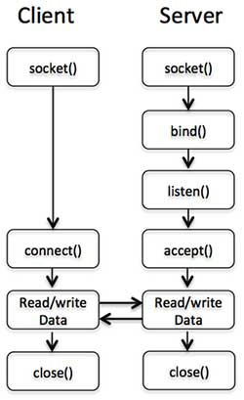
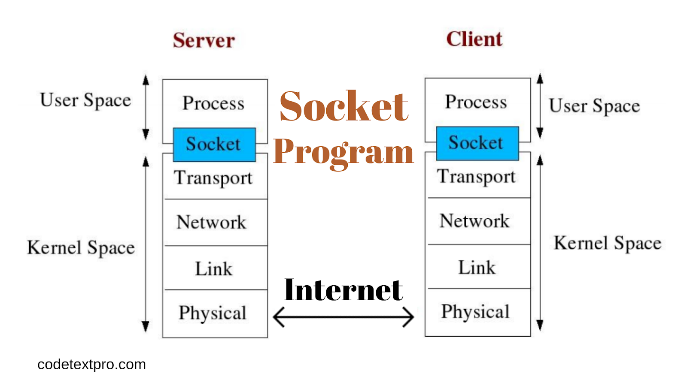
Day Time Server at port no. 13
Example ::
Day Time Client….

Slide 26
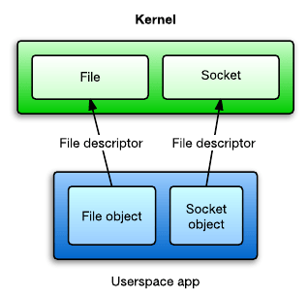
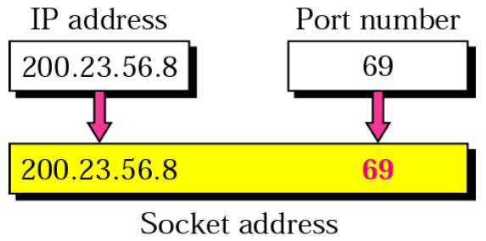
}
#include <sys/socket.h>
#include <sys/types.h>
#include <netinet/in.h>
#include <netdb.h>
#include <stdio.h>
int main(int argc, char **argv)
{
int sockfd, n = 0;
char recvline[1000 + 1];
struct sockaddr_in servaddr;
int port = 13;
if ((sockfd = socket(AF_INET, SOCK_STREAM, 0)) < 0) {
err(1, "Socket Error");
}
bzero(&servaddr, sizeof(servaddr));
servaddr.sin_family = AF_INET;
servaddr.sin_port = htons(port);
inet_pton(AF_INET,argv[1],&servAddress.sin_addr);
if (connect(sockfd, (struct sockaddr *) &servaddr, sizeof(servaddr)) < 0) {
err(1, "Connect Error");
}
Source Code of Day Time Client
AF_APPLETALK | Apple Computer Inc. Appletalk network
AF_INET | Internet domain
AF_PUP | Xerox Corporation PUP internet
AF_UNIX | Unix file system
127.0.0.1 -- > b'\x7f\x00\x00\x01'

Slide 27
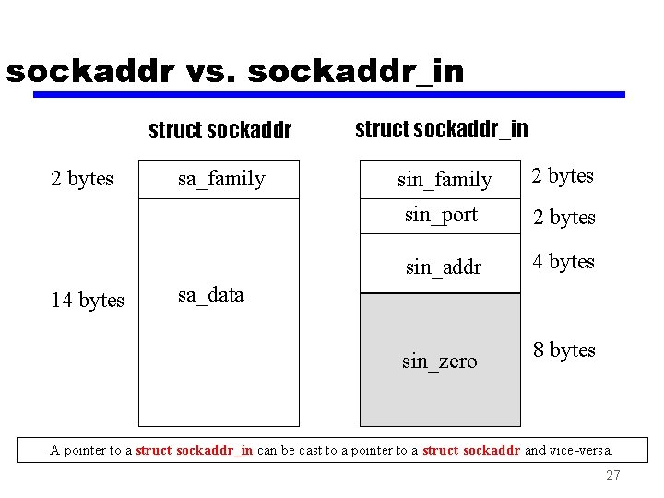
while ((n = read(sockfd, recvline, 1000)) > 0) {
recvline[n] = 0;
fputs(recvline, stdout);
}
return 0;
}

Slide 28
while ((n = read(sockfd, recvline, 1000)) > 0) {
recvline[n] = 0;
fputs(recvline, stdout);
}
return 0;
}
struct in_addr {
unsigned long s_addr;
};

Slide 29
DayTime Server…
#include <sys/socket.h>
#include <sys/types.h>
#include <netinet/in.h>
#include <netdb.h>
#include <stdio.h>
int main(int argc, char **argv)
{
int listenfd, connfd;
int port = atoi(argv[1]);

Slide 30
struct sockaddr_in servaddr;
char buff[1000];
time_t ticks;
listenfd = socket(AF_INET, SOCK_STREAM, 0);
bzero(&servaddr, sizeof(servaddr));
servaddr.sin_family = AF_INET;
servaddr.sin_addr.s_addr = htonl(INADDR_ANY);
servaddr.sin_port = htons(port);
CREATE A SOCKET
Initialize Socket Address

Slide 31
bind(listenfd, (struct sockaddr *) &servaddr, sizeof(servaddr));
listen(listenfd, 8);
for (;;) {
connfd = accept(listenfd, (struct sockaddr *) NULL, NULL);
ticks = time(NULL);
snprintf(buff, sizeof(buff), "%.24s\r\n", ctime(&ticks));
write(connfd, buff, strlen(buff));
close(connfd);
}
}
Bind the SOCKET
Listen on the Port for connections
Accept connection request from Client
Write to socket… { Serve the Client }

Slide 32
}
int main()
{
int s;
struct sockaddr_in6 addr;
s = socket(AF_INET6, SOCK_STREAM, 0);
addr.sin6_family = AF_INET6;
addr.sin6_port = htons(5000);
inet_pton(AF_INET6, "::1", &addr.sin6_addr);
connect(s, (struct sockaddr *)&addr, sizeof(addr));
while ((n = read(sockfd, recvline, 1000)) > 0) { recvline[n] = 0; fputs(recvline, stdout); }
close(sockfd);
return 0;
}
Source Code of Day Time Client – IPV6

Slide 33
}
Error Handling and Wrapper functions
In any real-world program, it is essential to check every function call for an error return we check for errors from socket, inet_pton, connect, read, and fputs, and when one occurs, we call our own functions, err_quit and err_sys, to print an error message and terminate the program.
We find that most of the time, this is what we want to do. Occasionally, we want to do something other than terminate when one of these functions returns an error
int Socket(int family, int type, int protocol)
{ int n;
if ( (n = socket(family, type, protocol)) < 0)
err_sys("socket error");
return (n);
}

Slide 34
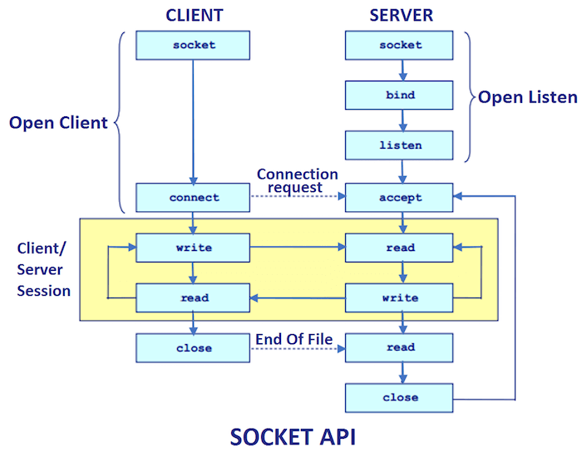

Slide 35
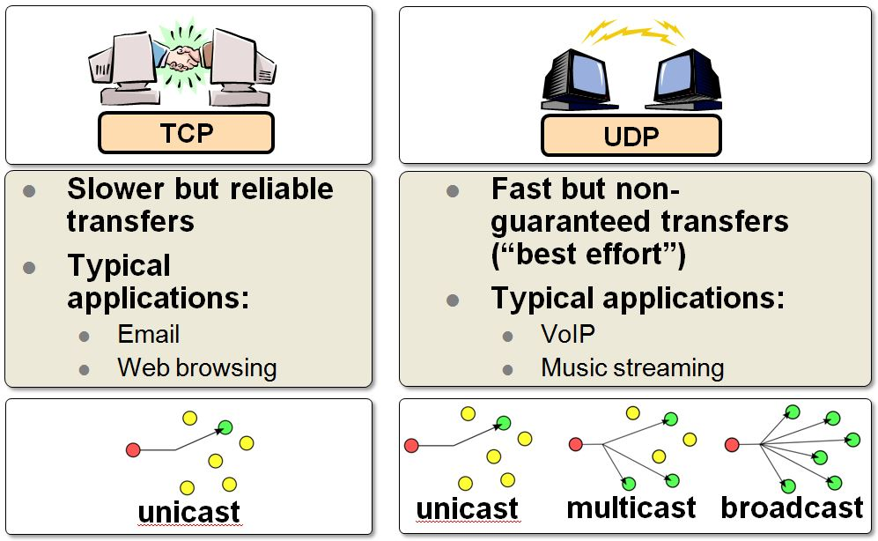
}
TCP AND UDP

Slide 36
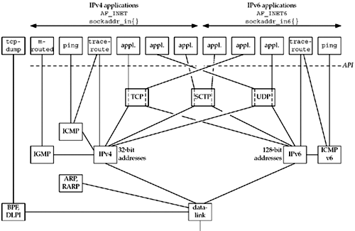
}
TCP/IP – The Big-picture

Slide 37
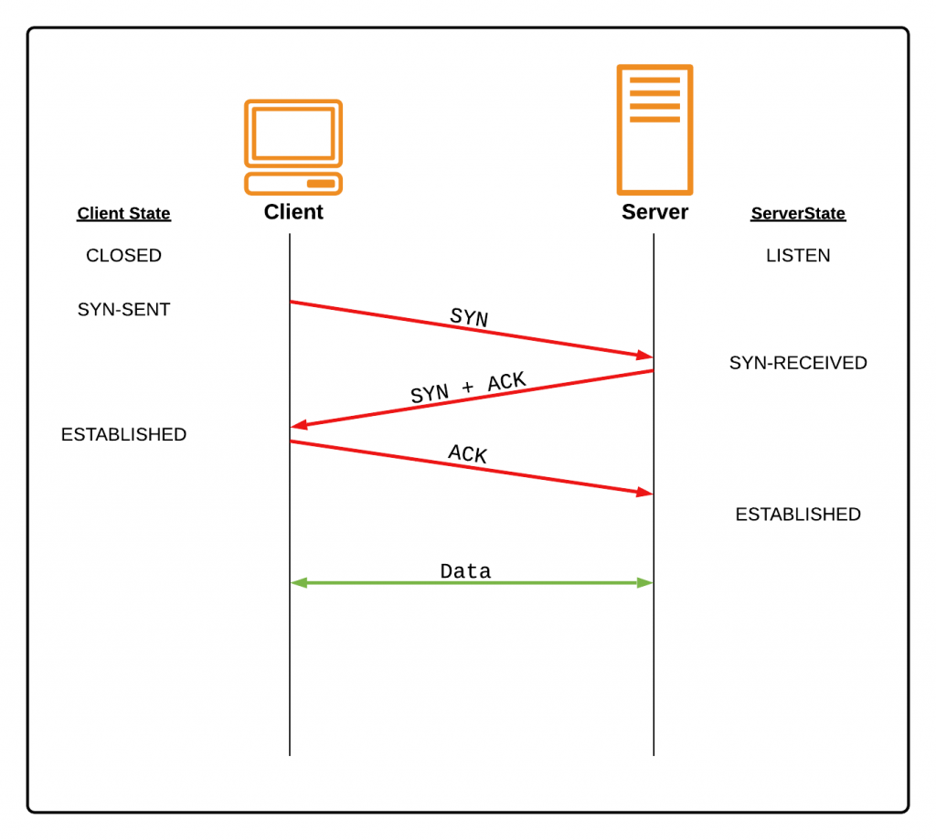
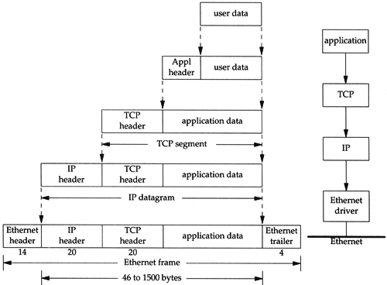
}
TCP - Connection

Slide 38
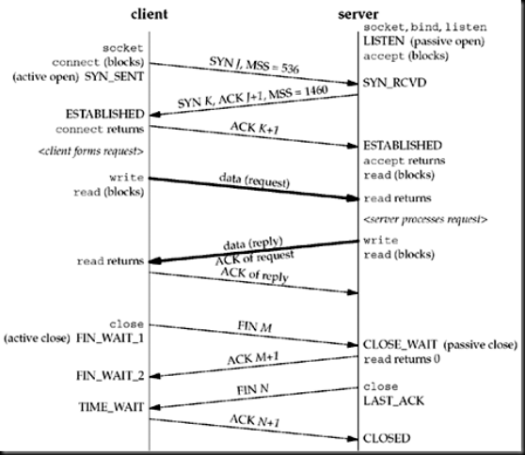
TCP – Connection : Packet Exchange

Slide 39
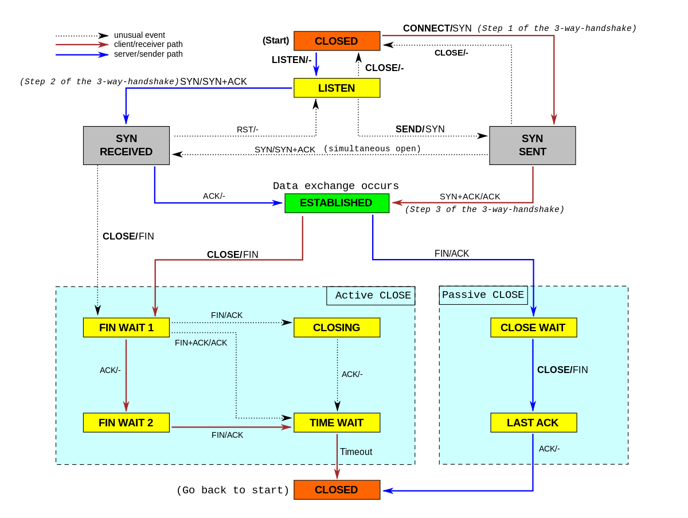
TCP-Connection state diagram

Slide 40
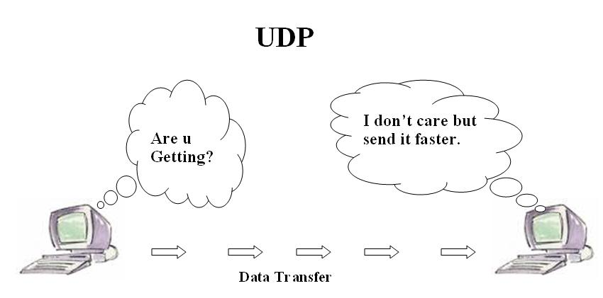
}
UDP

Slide 41
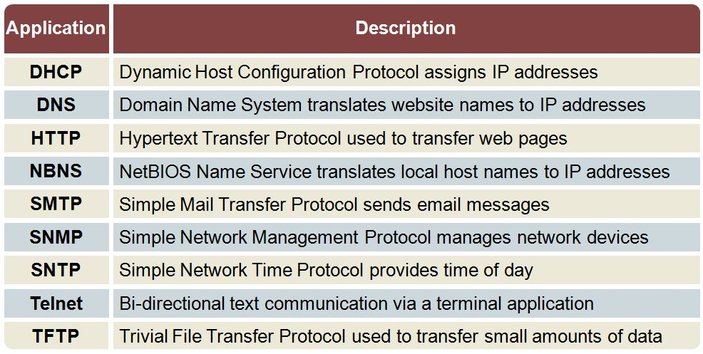
}
TCP Use cases

Slide 42
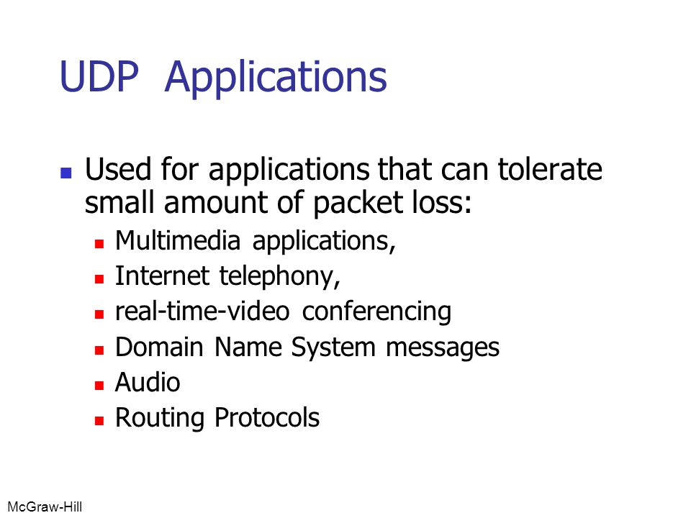
}
UDP Use cases

Slide 43
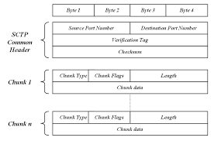
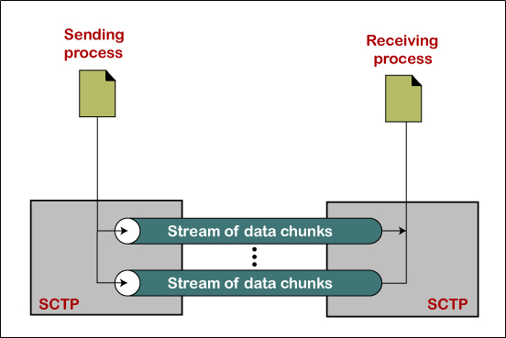
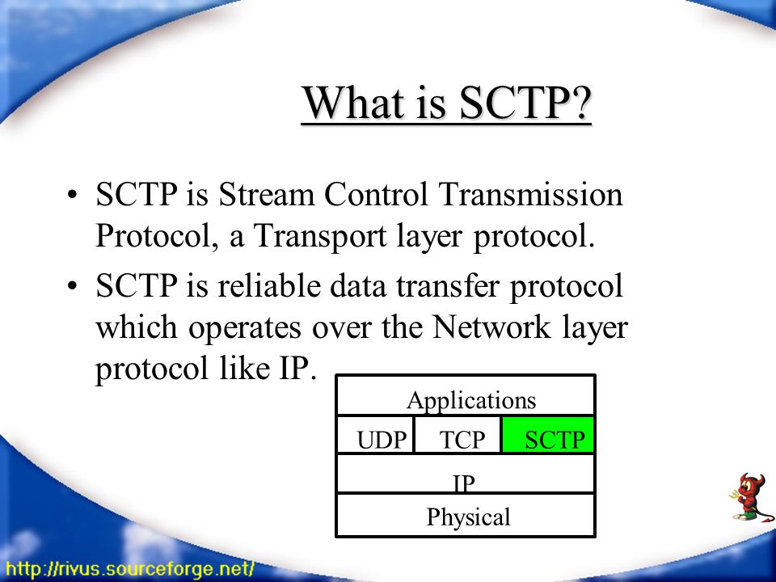
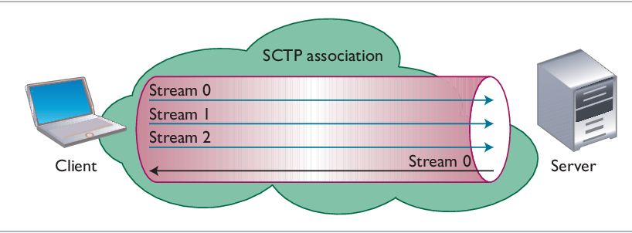
SCTP

Slide 44
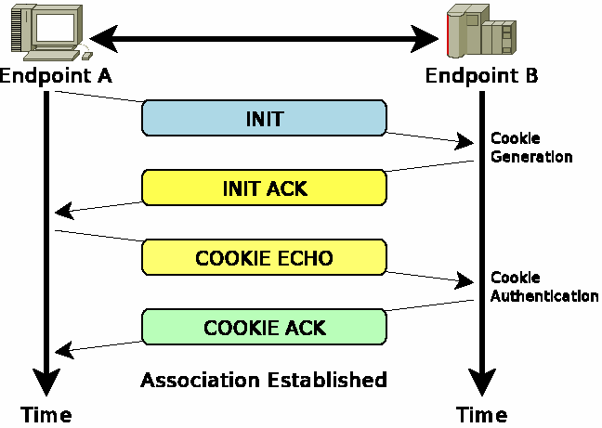
}
SCTP – 4 way Handshake

Slide 45
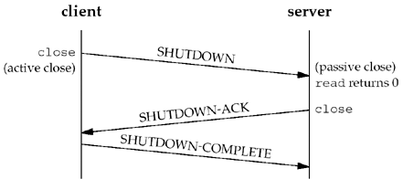
}
SCTP – Closing

Slide 46
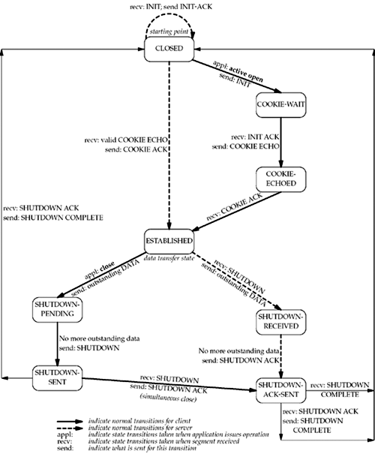
}
SCTP – State Transition Diagram

Slide 47
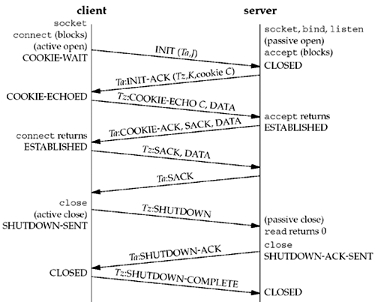
}
SCTP – Packet Exchange

Slide 48
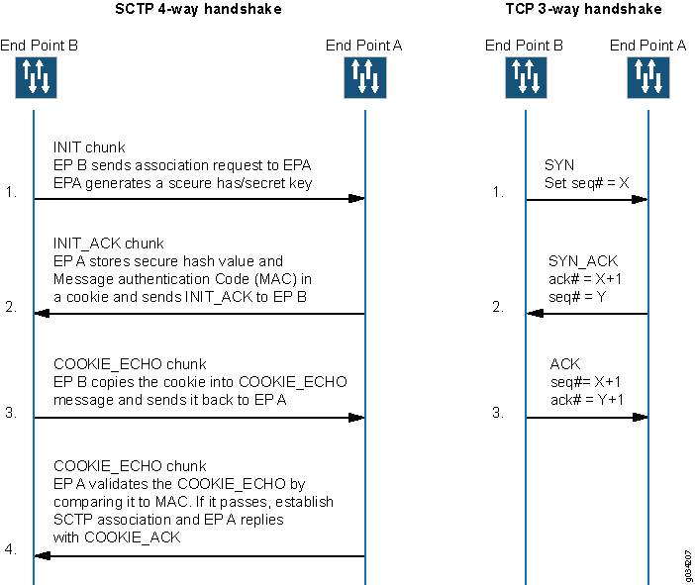
}
SCTP – 4 way handshake

Slide 49
}
SCTP – Options

Slide 50
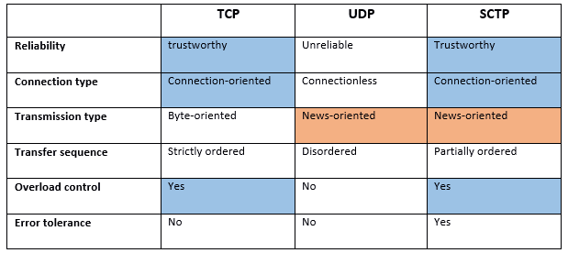
Comparison

